Slide 1
Capgemini response to
Maxis Wholesale
Market Landscape Research Brief
Capturing the Next Growth Frontier: Repositioning Maxis Wholesale at the Center of ASEAN’s Digital Infrastructure Economy
May 2026

Slide 2

01
Our Understanding of the RFI
Aligning on Maxis Wholesale’s ambition, scope, and the key questions this study must answer.
02
Why Capgemini
Establishing strategic fit through relevant telecom expertise and transformation experience.
03
Market View
Assessing market dynamics, demand drivers, and value shifts shaping wholesale growth opportunities.
04
Strategy Frameworks
Applying structured frameworks to define where to play and how to win in wholesale.
05
Capabilities
Bringing insight‑led strategy and execution capabilities to drive measurable impact.
06
Credentials
Demonstrating proven delivery through relevant case experience and outcomes.

Slide 3
OUR UNDERSTANDING OF RFI
Grounding the engagement in our understanding of Maxis’ wholesale ambition

Slide 4
Our Understanding of the RFI
Clarifying the context, objectives, scope, and strategic questions shaping the engagement.
SPECIFIC OBJECTIVES
WHOLESALE SCOPE AREAS
CONTEXT
1
Quantify market size & growth
(5-year outlook)
1
2
ICT value pools are shifting from retail connectivity → infrastructure & wholesale, driven by data centre expansion, AI/cloud demand, and cross-border traffic growth across Malaysia & ASEAN.
Connectivity
IP Transit
Cross-border, DCI, Dark Fibre
Market size, traffic, pricing
2
Identify key growth drivers & demand trends — Hyperscalers, AI Providers, MVNOs, Satellite
2
3
4
Data Center
Virtual Mobile (MVNOs)
3
Assess competitive positioning vs. regional players
Standard & AI DC inventory
PRIMARY OBJECTIVE
3
Active MVNOs, competitor landscape
Develop a growth blueprint for Maxis Wholesale to achieve substantial revenue growth through a structured, fact-based market view.
5
6
4
Define where Maxis should play and recommend optimal GTM model
Global Best Practice
Tower Infra & IBC
4
Telstra, Tata, Orange benchmarks
Infrastructure landscape
KEY QUESTIONS TO ANSWER
5
Provide clear, realistic & actionable strategic recommendations
7
8
5
Where to play & how to win?
Largest & fastest-growing opportunities?
Right to play vs. right to win?
Network API
Int'l Voice/Data
Demand forecast: Hyperscalers · LEO Satellite · AI Providers · MVNOs
API monetization opportunities
Inbound & outbound wholesale
Capgemini response to Maxis Wholesale Market Landscape Research Brief | May 2026
Company Confidential © Capgemini 2026. All rights reserved.
4

Slide 5
WHY CAPGEMINI
Positioning why Capgemini is the right partner for this transformation

Slide 6
Why Capgemini is the right partner for Maxis’ wholesale growth transformation
Capgemini combines market intelligence, telecom expertise, and execution capability to help Maxis capture and scale wholesale growth—not just identify it.
End-to-End: From Insight to Execution
Deep Telecom & Wholesale Domain Expertise
Data‑Led, Fact-Based Market Intelligence
Strategy + Transformation + Execution in One Partner
Ecosystem-Led Growth Enablement
We will go beyond market assessment to deliver actionable outcomes—translating insights into GTM strategy, business model design, and operating model transformation.
Our approach ensures Maxis moves from:-
Where to play → How to win → How to execute at scale
We will bring strong expertise in wholesale telecom and infrastructure-led business models, including Connectivity, IP transit, and DC interconnect, Hyperscaler, carrier, and ecosystem-driven demand, Commercial (pricing, margins) + operational (network, capacity) dynamics - to enable practical, segment-specific growth strategies
We will combine Premium market intelligence, Primary/Secondary research and expert inputs, Infrastructure-level insights (routes, capacity, pricing) - to deliver a triangulated, defensible view of wholesale growth pools across Malaysia & ASEAN, aligned to RFI expectations.
Unlike pure strategic research firms, we will provide - Strategy & GTM design, Operating model transformation, Digital enablement (pricing, provisioning, analytics) - ensuring faster implementation and measurable business impact, not just recommendations
We will help Maxis unlock value through ecosystem partnerships, including- Hyperscalers and cloud providers, Data center operators, Subsea and cross-border partners - enabling a shift from Capacity selling → Solution-led & ecosystem-driven monetization
1
2
3
4
5
Capgemini response to Maxis Wholesale Market Landscape Research Brief | May 2026
Company Confidential © Capgemini 2026. All rights reserved.
6

Slide 7
MARKET VIEW
Establishing the external and internal context shaping wholesale demand

Slide 8
Wholesale providers are transitioning from infrastructure players to platform orchestrators, with ecosystem-led monetisation driving the next wave of growth
Ecosystem Monetisation
Wholesale providers are at a strategic inflection point. While demand for connectivity continues to grow, value is shifting away from pure capacity monetisation toward ecosystem-driven value creation.
To achieve scaled growth, providers must evolve from network owners into platform orchestrators, enabling real-time collaboration across partners, customers, and services.
This transformation requires:
Moving beyond connectivity monetisation → ecosystem monetisation
Shifting from volume-led growth → monetisation-led growth models
Building a marketplace / platform layer to aggregate, orchestrate, and scale services
Leading wholesale players are already unlocking four new revenue streams:
API Monetisation – exposing network capabilities as programmable services
Ecosystem Service Bundling – integrating connectivity with DC, cloud, and digital services
Partner-Led Growth Acceleration – scaling through faster onboarding and broader partner access
Data Monetisation – leveraging network insights, demand patterns, and analytics
Partner Network Effects
Scalability (Platform-driven)
Wholesale 2.0: Platform-Led Growth
Data & Intelligence Monetisation
API Economy
Agility (On-demand services)
Source: TMForum, IDC, Capgemini Strategic Research
Capgemini response to Maxis Wholesale Market Landscape Research Brief | May 2026
Company Confidential © Capgemini 2026. All rights reserved.
8

Slide 9






Malaysian Market Shifts and Demand Dynamics Shaping Wholesale Growth
Global & Regional Shift Toward Wholesale
Projected Data Usage
ICT value is migrating from retail consumer connectivity to back-end infrastructure & wholesale provisioning
Malaysian DC boom in Johor & Cyberjaya driven by land, power economics & government policy
Retail ARPU compression from aggressive unlimited-data price wars (plans <RM 50) vs. rising 5G CAPEX
51.9 GB
per user/month by 2029
Why Wholesale Demand is Accelerating
DC Connections
AI, cloud & hyperscalers (AWS, Azure, GCP) require dedicated dark fiber, wavelengths & high-capacity IP VPN
MVNOs & LEO satellite operators (e.g. Starlink) create new wholesale demand for backhaul & network access
AI training clusters require 10–100x higher power density than traditional data centers, giving rise to megawatt‑scale AI data centers with extreme bandwidth and resilience needs.
Large‑scale AI model training generates petabytes of data movement, creating sustained and predictable wholesale demand suited to long‑term dark fiber and capacity contracts.
Hyperscalers are accelerating AI inference deployments closer to users, positioning Southeast Asia—and Malaysia in particular—as a strategic low‑latency hub between Singapore and ASEAN markets.
39+
major DCs on Maxis network
Enterprise Revenue
RM 1,665M
Maxis Wholesale Growth Ambition
FY25 · +3.4% YoY
Transition from organic growth to Scaled Growth via a structured, scientifically targeted market approach
Quantify 5-year TAM across Malaysia & ASEAN; benchmark against TM, CelcomDigi, Telstra, Tata, Orange
Define right to play vs. right to win and recommend an optimal Go-To-Market operational model
Capgemini response to Maxis Wholesale Market Landscape Research Brief | May 2026
Company Confidential © Capgemini 2026. All rights reserved.
9

Slide 10





Maxis Financial Performance, Strategic Signals & Wholesale Growth Catalysts
Financial snapshots, leadership signals & demand accelerators
Business Snapshot
Subscribers
Service Revenue
Enterprise Rev.
EBITDA
~9.98M
RM 8,912M
RM 1,665M
~RM 4,300M+
FY24–FY25
FY25 +0.5% YoY
FY25 +3.4% YoY
Record high FY25
Strategic Direction (CEO & Leadership Signals)
CEO Goh Seow Eng: "Strengthen consumer segment and expand enterprise offerings beyond connectivity, including the growth of our wholesale business“ (Official Maxis Press Release)
Infrastructure & Connectivity
Enterprise Ecosystem Expansion
Wholesale as Core Pillar
Proprietary fibre rollout (100K+ homes in Penang by 2027); 2 new cross-border fibre routes MY↔SIN & MY↔THAI
"Connectivity + 1" – cloud, managed IoT, cybersecurity & Quantum Safe Networking
Explicitly a strategic priority: transition from capacity lessee to primary lessor for DCs & hyperscalers
Why Wholesale Matters Now (Demand Accelerators)
AI, Cloud & DC Growth: 39 major DCs connected; Johor & Cyberjaya expansion; hyperscalers requiring dark fibre & managed wavelengths
Cross-Border Infra Demand: MY–SIN & MY–THAI corridors; terrestrial land bridge for SEA data transit to global subsea cable hubs
MVNOs & LEO Satellites: New wholesale client class – MVNO network hosting; LEO earth stations needing ultra-high-capacity fibre backhaul
Capgemini response to Maxis Wholesale Market Landscape Research Brief | May 2026
Company Confidential © Capgemini 2026. All rights reserved.
10

Slide 11
STRATEGY FRAMEWORKS AND MODEL
Introducing the strategy frameworks guiding our recommendations

Slide 12
Designing an integrated go‑to‑market and operating model to enable scaled wholesale growth.
STRATEGY
Market Analysis
Target Industries & Enterprises
Product/ Service Offering Design
Business Model
Strategy
Strategic Partner Identification
Marketing Strategy
Quantify wholesale ICT opportunity (MY + ASEAN)
Identify growth pools: connectivity, IP transit, DC, MVNOs
Analyse demand drivers: AI, hyperscalers, cross-border traffic
Prioritise hyperscalers, carriers, OTTs, MVNOs
Identify high-value customers & early adopters
Focus on traffic-intensive and cross-border demand segments
Define differentiated wholesale portfolio:
Align offerings to AI / cloud-driven demand
Optimise monetisation:
Drive asset utilisation & route-level value capture
Build bundled and ecosystem-led offerings
Identify hyperscalers, DC operators, subsea consortia,Enable ecosystem-led growth vs standalone selling
Sharpen wholesale positioning by segment,
Target priority routes (MY–SG, MY–TH, domestic corridors),Build visibility in AI, DC, connectivity ecosystems
Launch and Rollouts
OPERATIONS
Success Metrics
Customer Support
Operations Capability Realignment
Digital Landscape Enablement
Sales Enablement
Operational Sustainability and Review
Revenue growth by segment
Network utilisation & capacity monetisation
Share in priority wholesale segments
Dedicated strategic account management
High-reliability SLAs for carriers & hyperscalers
Establish scalable wholesale operating model
Align governance across network, enterprise, partnerships
Streamline pricing, provisioning, contracting
Deploy platforms for pricing, quoting, provisioning
Build network visibility (capacity, utilisation, routes)
Enable analytics-driven demand forecasting
Shift from capacity-selling → solution-selling
Equip teams with wholesale & ecosystem propositions
Continuous optimisation via customer feedback loops
Refine pricing, portfolio, and utilisation
Our Capabilities:
GTM strategy
Business Model Strategy
Portfolio Diversification
Customer and Market Analysis
Digital Transformation
Process Redesign
Marketing, Campaigns & content
Agile Program Management

Slide 13
Translating market insights and analysis into a clear five‑year growth blueprint.
Discovery & Scoping
Interviews with Maxis Wholesale & Enterprise stakeholders to align on scope
Agree on wholesale market study methodology
Project mobilisation & governance setup
Define priority segments (connectivity, IP transit, DC, MVNO, etc.)
Stakeholder mapping across network, enterprise, strategy teams
Workshop planning & execution
Define data requirements (market, traffic, capacity, pricing)
KPI definition aligned to growth objectives (revenue, utilisation, market share)
Assessment
Validate existing wholesale GTM strategy & offerings
Analyse market size, growth pools & demand drivers (AI, hyperscalers, cross-border traffic)
Assess connectivity assets (fibre, subsea, routes, capacity vs utilisation)
Evaluate product & service portfolio (IP transit, DC interconnect, MVNO enablement)
Benchmark against regional & global wholesale leaders (e.g., Singtel, Telstra, Tata)
Assess operating model (people, processes, governance, technology)
Analyse pricing benchmarks (IRU, fibre, IP transit)
Recommendations
Define Wholesale Growth Blueprint (“Where to Play / How to Win”)
Target segment & geography prioritisation (MY + ASEAN, key routes)
To-be product & service portfolio (connectivity, DC, APIs, etc.)
Differentiated value propositions by segment (hyperscalers, carriers, MVNOs)
Optimal GTM model & partnership strategy
Operating model evolution for scalable wholesale growth
Revamped Business Model
Wholesale monetisation strategy
Hyperscaler & ecosystem partnerships
New revenue pools (DC, APIs, cross-border capacity)
Market Segment & GTM
Business Model
Optimized Product portfolio
Connectivity (fibre, subsea, routes)
IP Transit & DC interconnect offerings
Pricing models (IRU, capacity, usage-based)
Dimensions for consideration
Products & Services
New GTM Strategy
Segment prioritisation (hyperscalers, OTTs, MVNOs, carriers)
Target routes & geographies
Wholesale brand positioning
Operating Model
Revamped Operating Model
Wholesale organisation structure
KRAs / RACIs aligned to growth
Data, tools & analytics for market intelligence
Inputs:
Maxis’s Business Strategy
Network infrastructure & asset base (fibre, subsea, capacity)
Existing pricing, contracts, and partnerships
Industry Best Practises
Capgemini’s ESOAR
Eliminate
Standardize
Optimize
Automate
Robotize
TMForum Framework
Key Outcomes
5 Year Outlook
key growth drivers and demand trends
Competitive positioning
optimal GTM model
Strategic Recommendation
Capgemini response to Maxis Wholesale Market Landscape Research Brief | May 2026
Company Confidential © Capgemini 2026. All rights reserved.
13

Slide 14
Structuring a phased approach to assess the current business model and design the future state.
Key ‘In-Scope’ Considerations
Business Model Components Coverage
Markets Coverage
Product Coverage
Wholesale customers & journeys
Products
Channels
Wholesale & Enterprise
Infrastructure
Consumer
MVNO
Connectivity
IP Transit
Infrastructure
Data Centre interconnect & ecosystem services
Network API
Methodology
STAGE I
‘AS-IS’ ASSESSEMENT & BASELINING
STAGE II
FUTURE MODE OF OPERATIONS DESIGN
STAGE III
EXECUTION PLANNING
Understand Maxis Wholesale ambition, targets, and current growth trajectory Analyse insights from Existing wholesale & enterprise initiatives , Network & infrastructure utilisation Identify key pain points and Assess business model components
Perform market opportunity & gap assessment Define growth blueprint & implementation roadmap Finalise business requirements for scaling wholesale Design future operating model
Prioritise recommendations: Define execution roadmap with stakeholders Define change management considerations
The key tenets of solution for Business Model assessment & validation
CG’ Approach & methodology for Business Model components assessment
CG Frameworks/ Accelerators
Telco Experienced consultants
Capgemini response to Maxis Wholesale Market Landscape Research Brief | May 2026
Company Confidential © Capgemini 2026. All rights reserved.
14

Slide 15



Capgemini offers a unique set of assets & capabilities to support the end to end development of innovative & high value use cases
1 | Use cases ideation & prioritization
2 | Development & test
3 | Scale-up
Priorization & roadmap
Discovery & Ideation
Process/domain analysis: pain points & transformation priorities
Design thinking workshops/
in situ observation
Benchmarks
Identification of opportunity territories
Use cases collection & ideation
Use cases development – wave 1
Scale-up
Use cases portfolio
Use Cases prioritise
Solutioning, partners selection, development, integration
…
Lessons learnt
Experience
& Operations
Business case
Go/No Go
Upgrades, implementation & change management
Use cases development – wave 2
MVP testing
Roll-out
Technical feasibility
Lab/pre-production environment
Production environment
Expertise & accelerators
Vertical expertise: SMEs, benchmarks, client ecosystem
Consulting services: design thinking, innovation,
business case, technology strategy
Libraries of use cases & micro-services
5G & Edge Labs & Innovation Centers
Application development
Service enablement platform
Network | IT | OT integration skills
Digital factory model
Capgemini response to Maxis Wholesale Market Landscape Research Brief | May 2026
Company Confidential © Capgemini 2026. All rights reserved.
15

Slide 16
Illustrating how data‑center connectivity can be monetized through a scalable wholesale model
Key Partners
Key Activities
Value Proposition
Customer Relationship
Customer Segments
Subsea cable consortia & regional carriers
Data centre operators (Equinix, Bridge Data Centres, PDG, etc.)
Hyperscalers (AWS, Microsoft, Google)
Cross-border partners (MY–SG, MY–TH routes)
Infrastructure & fibre partners in Malaysia
Pre – Market development, solution-led wholesale selling
Mid – Account management, solution design, deal structuring (IRU / capacity)
Post – Network operations, NOC monitoring, SLA-driven service management
High-capacity, low-latency connectivity across key routes (MY–SG, MY–TH, domestic backbone)
Resilient, carrier-grade infrastructure (high availability, secure)
Fast provisioning & scalable capacity for hyperscaler workloads
Integrated offerings: connectivity + DC interconnect + IP transit
Dark fibre & high-bandwidth solutions for AI / cloud demand
Pre-sales
Strategic account mgmt. (hyperscalers, carriers)
Solution engineering & technical validation
Post-sales
Dedicated account manager
SLA-driven service assurance & escalation support
  Hyperscalers (AWS, Microsoft, Google, ByteDance)
  Global & regional carriers (NTT, Singtel, etc.)
  Data centre providers (Equinix, Vantage, PDG, Bridge)
  OTTs / content players
  MVNOs & enterprise customers requiring DC connectivity
Key Resources
Channels
Network
Domestic fibre backbone & cross-border routes
Subsea cable access & DC interconnect infrastructure
Platforms / Systems
OSS / BSS for provisioning, billing, monitoring
Network analytics
People
Wholesale sales & solution teams
Network operations & NOC
Partnerships & ecosystem management
Industry events (Capacity Asia, PTC, etc.)
Direct enterprise & carrier sales
Strategic partnerships & alliances
Digital channels (thought leadership, targeted outreach)
NOC / service desk interface
Cost Structure
Revenue Streams
CAPEX: Fibre expansion, cross-border capacity, DC interconnect
Subsea & infrastructure investments
OPEX: Network operations, maintenance, power, staffing
Sales & partnership management costs
  Dark fibre & capacity leasing (IRU / long-term leases)
  IP transit (usage-based pricing)
  DC interconnect & cross-connect services
  Bundled wholesale offerings (connectivity + DC + IP)
  Premium pricing for low-latency, high-availability routes
Capgemini response to Maxis Wholesale Market Landscape Research Brief | May 2026
Company Confidential © Capgemini 2026. All rights reserved.
16

Slide 17
STRATEGIC RESEARCH APPROACH & METHODOLOGY
Introducing the research engine underpinning our fact‑based insights

Slide 18
Structured methodology and robust process to build high quality reports from a greenfield start state
1
2
3
IDENTIFY THE NEEDS AND
FORMULATE THE OBJECTIVES
CHALK OUT THE PROJECT
CHARTER
BUILD THE RESEARCH
DESIGN
Understand the context,
Identify the key questions to be addressed,
Understand scope, coverage and timelines
Conduct preliminary analysis
Initiate hypothesis testing
Build the project charter
Create the storyboard
Secondary research –Subscription research databases, analyst reports, industry association websites, Company annual reports/SEC filings, CXO briefings, free text search
Qualitative research- In-depth interviews, Focus group discussions, Expert/SME interviews, Observatory research
Quantitative research- Face to face surveys, telephonic surveys, online surveys
6
5
4
REPORT BUILDING AND
VISUALIZATION
DRAW KEY INSIGHTS AND RECOMMENDATIONS
ANALYZE THE DATA
Build and design the concise PDF or PPT report
Visualization of key metrices
/findings/recommendation through presentations, dashboards and infographic as applicable.
Build the key messages and so-what takeaways,
Draw the final recommendations
Statistical analysis,
Key driver or Root Cause analysis
Predictive data analytics
Capgemini response to Maxis Wholesale Market Landscape Research Brief | May 2026
Company Confidential © Capgemini 2026. All rights reserved.
18

Slide 19
A ‘solutionized’ benchmarking approach using advanced analytics and automation to provide actionable insights
Solution overview
Benchmarking objective and parameters finalization
Identify long-list
Of peers
Benchmarking Approach
Data Collection
Data analysis and draft report
Key insights and recommendations
Finalizing a smaller peer set for comparison
Insights/
Data sources
Internal intelligence
Premium databases
Public sources / survey
Large-scale cross industry benchmarking exercise can provide seed data for new sales opportunity to clients. E.g. Benchmark GenAI adoption status/ readiness
Identify best practices, generate hypothesis
Identify KPIs / metrics
SMEs from various industries/ functions with deep expertise in their domains / markets
Access to market databases that provide a range of economic, operational, demographical, and other related intelligence
Survey design and publicly available information related to regional stats, industry benchmarks, key trends etc.
Perform opportunity analysis
FINANCIAL PERFORMANCE AND OPERATIONAL EFFICIENCY
SUPPLY CHAIN
CX
TECHNOLOGY ADOPTION
BUSINESS
QUESTION/ PROBLEM
How do my processes compare to industry standards?
What best practices can improve productivity and reduce costs?
What are the industry benchmarks for inventory turnover?
How to assess supplier/vendor concentration
What factors drive customer loyalty for top performing companies?
How advanced is my tech stack compared to my competitors?
What is the AI strategy/ digital maturity of my peers?
Process benchmarking to identify gaps and optimize workflows
Time and motion studies to stream-line operations
Benchmarking inventory metrics for industry & competitor
Analysing risks and dependencies to derisk supply chains
Comparative analysis of loyalty programs and effectiveness
Tech benchmarking for software, tools and IT infrastructure
Identify gaps and establish long-term strategy/digital maturity
BENCHMARKING
SOLUTION
Capgemini response to Maxis Wholesale Market Landscape Research Brief | May 2026
Company Confidential © Capgemini 2026. All rights reserved.
19

Slide 20













Access to Premium Research Databases to validate information and generate reliable and value-added insights
INTERNAL INTELLIGENCE
Industry SMEs and functional experts with experience in Asia and other global markets
REPRESENTATIVE SETS
In-house SME insights
Accelerators & Frameworks
Insights from
previous research
In-house
Knowledge
PREMIUM DATABASES
Access to market databases that provide a range of economic, operational, demographic, and other related intelligence
Verified
Public Information
Subscribed
Reports
PUBLIC SOURCES
Publicly available information related to regional stats, industry benchmarks, key trends, etc.
Capgemini response to Maxis Wholesale Market Landscape Research Brief | May 2026
Company Confidential © Capgemini 2026. All rights reserved.
20

Slide 21
CAPABILITIES AND ENABLERS
Driving strategy and execution through Capgemini’s integrated research and consulting capabilities

Slide 22
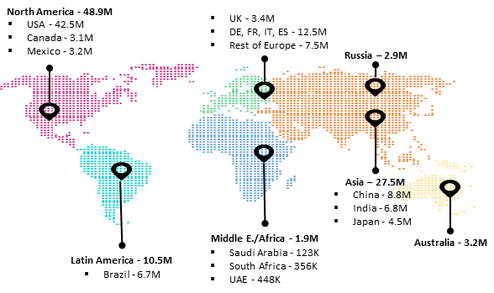






















We have a comprehensive suite of research and insight offerings to support strategic decision‑making
TEAM
HOW WE CAN HELP
MARKET LANDSCAPE
BENCHMARKING
WATCHTOWER / INSIGHTS CENTRE
ACQUISITIONS / JV
CONSUMER RESEARCH
LOCATION ASSESSMENT
200+
member strong
delivery team
Market Opportunity Assessment
Product Opportunity Assessment
Current Sector Dynamics
Best Practices
Operational Benchmarking
Vendor and Competitor
Benchmarking
Maturity Assessment
POVs on Emerging Tech Areas and Business
Periodic Customized Research
Bespoke Newsletters and Articles
Dashboards and Syndicated Reports
Acquisition Target Scouting
Partnerships Opportunity Assessments
Financial Analysis
Usage & Attitude
Customer Satisfaction
Shopper Research
Customer Experience Management
Market Entry Strategy
Target Location Analysis
Micro and Macro-economic Assessments
18+ years
of experience in market research
Exposure to working with clients in
20+ Countries
PANELIST REACH
DATABASES
CLIENTS
Specialists across a
majority of Industries
& functions
Automotive
Manufacturing
Financial Services
Consumer Products & Retail
Life Sciences
Telecom
Media & Tech
Energy & Utilities
Public Services
GenAI
Digital CX
Metaverse
Industry 4.0
5G
Captives
Acquisition scouting
Capgemini response to Maxis Wholesale Market Landscape Research Brief | May 2026
Company Confidential © Capgemini 2026. All rights reserved.
22

Slide 23


























Our end‑to‑end Telecom Consulting capabilities will enable effective strategic execution
Digital Telco Business Transformation Advisory
Digital Telco Process Transformation Advisory
Telco Program Management
Telco Business Architecture blueprinting
Telco Gen AI advisory
Cloud
Transformation
Agile Advisory & BIzOps
Product Management
using Digital Factory
IT Strategy & ITOM
IT M&A, IT Cost
Optimization &
Business Case
Data Advisory
AI/ML enabled Insights
Business
Intelligence & Reporting
Data Engineering
CM
for Tech Implementation​
HR Transformation
Workforce strategy
Agile Organization
Sustainable Business Strategy
Sustainable Performance & Reporting
Sustainability Leadership & Organisation
Design Innovation & Strategy
Brand & Content
Customer Transformation
Supply Chain Transformation
Digital Core
Digital Engineering
Insights for Intelligent Industry
ERP Advisory & Product Evaluation
Finance Process Design
Finance Transformation with S4HANA, Digital Finance
Target operating model & design
People Analytics Advisory
Strategic Workforce Planning
People BI Solutions
Capgemini response to Maxis Wholesale Market Landscape Research Brief | May 2026
Company Confidential © Capgemini 2026. All rights reserved.
23

Slide 24
CREDENTIALS

Slide 25
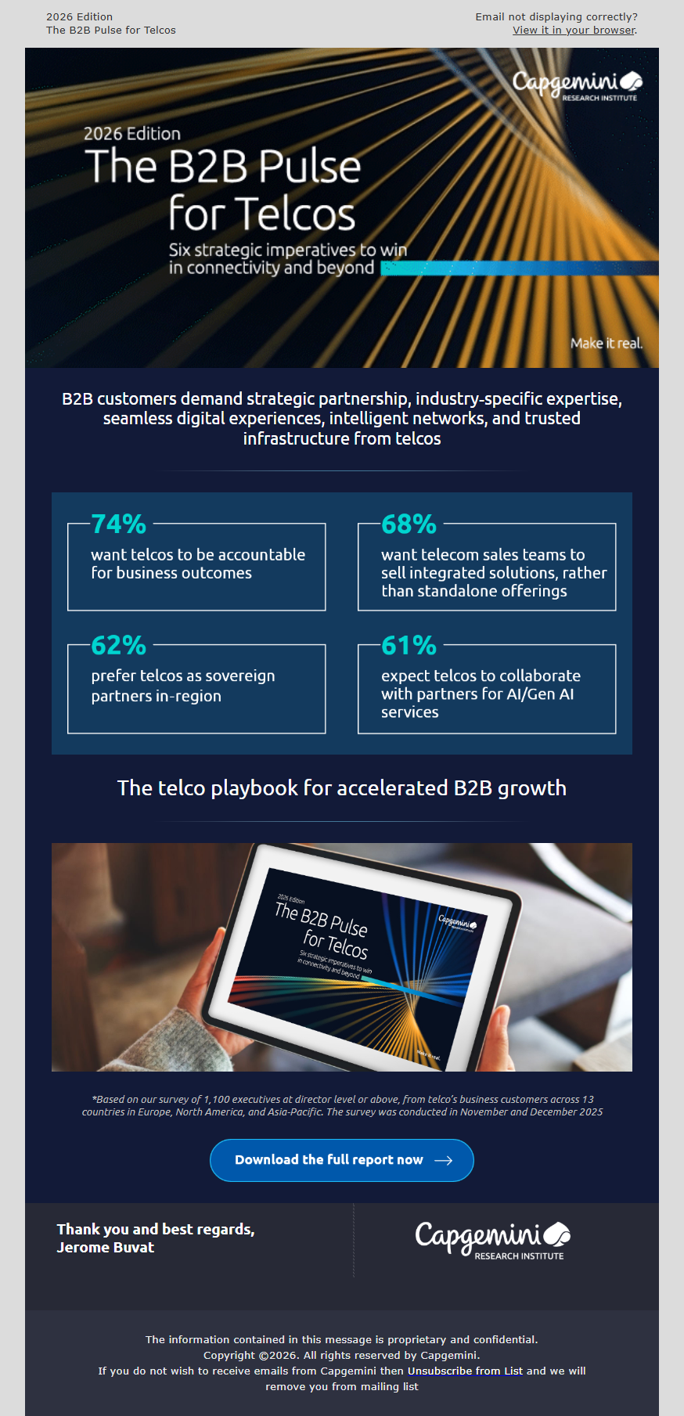
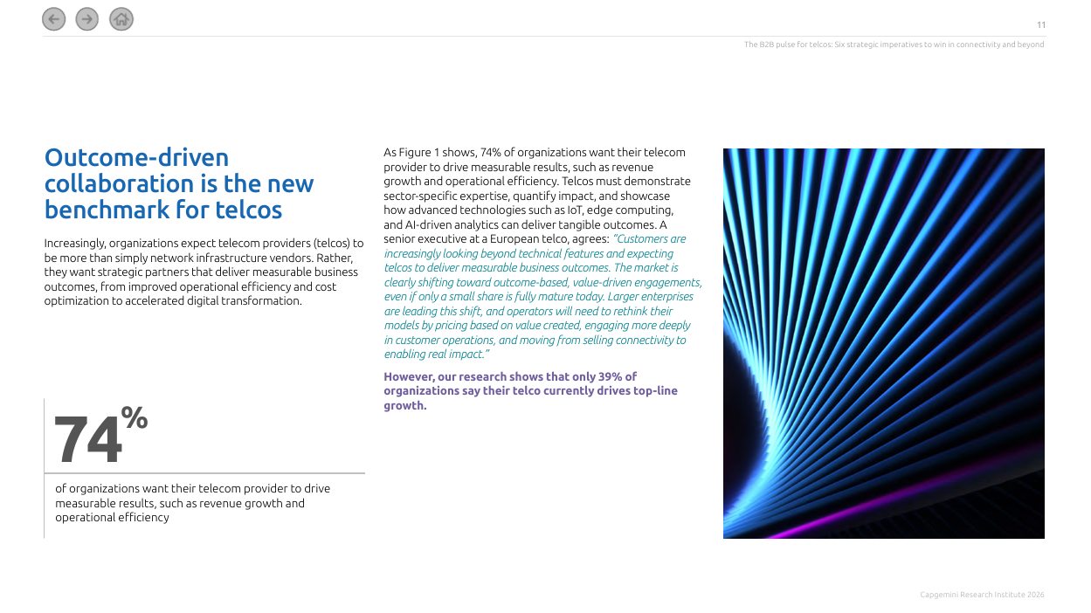
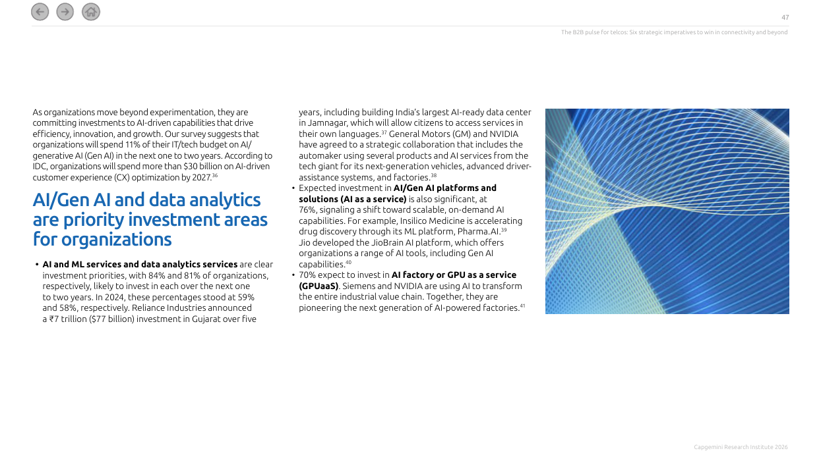
Research analyzed consumers expectation gaps and suggested six strategic priorities for telcos
Thought Leadership Research
This is the second edition of our B2B Pulse for the telecom industry, an annual study examining the evolving needs, challenges, and experiences of business customers across sectors.
The report highlights the pain points organizations face with telecom providers (telcos) and identifies six priority areas where providers must improve to strengthen service delivery and unlock greater business value.
This year’s study identifies the key expectation gaps between what business customers need and what telcos currently deliver, drawing on insights from 1,100 organizations across 13 countries and 13 industries, complemented by in-depth executive interviews. It highlights six priority areas where telcos must improve, spanning solution relevance, ecosystem orchestration, trust, network intelligence, next-gen services, and digital experiences.
Read our report to know more
25

Slide 26
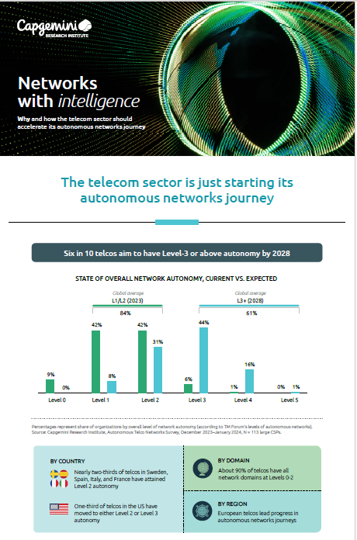
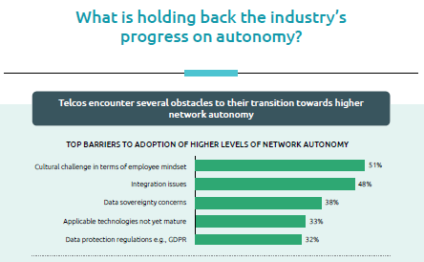
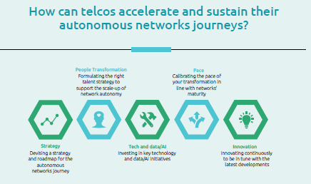
As telecom industry is steadily moving toward autonomous networks, our research identified and highlighted hurdles for telecom players
Thought Leadership Research
While most telcos (84%) currently reside at Level 1 or Level 2 autonomy for their overall networks, aspirations for higher levels of automation remain optimistic. Over 60% of operators aim to reach Level 3 autonomy or higher by 2028. However, the path to full autonomy is fraught with challenges, both technological and organizational.
In this Capgemini Research Institute report, ranked No 3 by Source Global among 400+ reports in 2024, Networks with intelligence: Why and how the telecom sector should accelerate its autonomous networks journeys, we provide comprehensive insights into the importance of autonomous networks for telcos and how these autonomous networks are best implemented.
The report found that some of the biggest obstacles hindering progress toward autonomy are the mindset of employees, integration issues, and regulatory concerns around data sovereignty.
Read our report to know more
Capgemini response to Maxis Wholesale Market Landscape Research Brief | May 2026
26

Slide 27




Structured Approach to Scaling Enterprise Growth – From Market Insight to Strategic Choices
Business
Problem
Why we
were chosen
Solution
Business
Benefits
Losing market share in B2B space to its nearest competitor
Lack of automation and digitization which resulted in long turn around times for key processes
Slow time to market for new products that inhibits the pace of innovation
High back-office cost as a result of high order fallout rate
Digital Telco Solution for Global Telcos
Deep client engagement with CXO community including business heads
Strong regional and global partnership with salesforce and Vlocity
Experienced regional team on Salesforce and Vlocity product skills
Strong reference from other successful B2B Telco implementations
To implement the ESOA (Eliminate, Standardize, Optimize and Automate) framework thereby harmonizing the L2C process across all types of enterprise customers
Phase -1 for Leads to Cash Transformation of B2B Business
Product Modelling of 8 product families on the new platform
Integration with legacy billing and fulfilment systems
Business benefits baselining and tracking through multiple phases of transformation
Opportunity Conversion rate (win rate) to improve by 50%
Average Time for Order activation to reduce by 50%, Order Fallout Rate to drop by 25%
Average time for Quote to Order to reduce by 25%
Acceleration of product development and Decrease in acquisition costs
Capgemini response to Maxis Wholesale Market Landscape Research Brief | May 2026
Company Confidential © Capgemini 2026. All rights reserved.
27

Slide 28
Driving B2B Growth Through CRM-Led Digital Transformation
Launched innovative solutions to market faster & serve with unparalleled agility.
Empowered Telco’s digital vision, Increased competitiveness, enabled digital experience for the customers.
Business
Problem
Why we
were chosen
Solution
Business
Benefits
Losing market share in B2B space to its nearest competitor due to inferior offerings
Inability to provide flexibility to customer to take advantage of growing competition
Next gen capability to sales, care application to enable best offer selection and optimized workflows for quote to order handling
Stagnant B2B Postpaid customer base due to non-availability of Mobile Number Portability (MNP)
Capgemini was awarded as the Salesforce Implementation Partner of the year across APAC region for the Telco's CRM Transformation
Experience with Digital Telco Integration Solution across geographies
Capgemini leveraged the integration capabilities built with existing Telco's downstream systems to enable 5G offerings for B2B customers
Salesforce Sales and Service Cloud capabilities such as case management, knowledge management, case routing and customer service request
Vlocity EPC as enterprise commercial catalogue for product modelling and time-to-market, easy configuration, customization, Bundling of B2B products and plans
Vlocity CPQ, Vlocity CLM and Vlocity COM combined with Mulesoft Integration platform to follow industry standards for a catalogue-driven order management approach
Faster lead conversion rate; 100K conversions within 6 months post launch
Better Opportunity win rate; Increased cross-sell/up-sell by 25%
Fully automated and integrated systems for provisioning; Faster turnaround on the quotes & order from 2-3 days to 10 min
Capgemini response to Maxis Wholesale Market Landscape Research Brief | May 2026
Company Confidential © Capgemini 2026. All rights reserved.
28

Slide 29
Operating Model Transformation to Enable Agility and Accountability for a Leading APAC Telco
Business
Problem
Why we
were chosen
Solution
Business
Benefits
Telco’s technical services function is distributed across many divisions and departments, and has evolved such that, there are several “Shadow” IT Functions where business or digital teams are making isolated decisions, including software selections, choosing implementation partners, and then transitioning IT support to ISG.
Lack of alignment in vision, fragmented collaboration and siloed operations is a major cause for concern for OCIO
Emphasis on ring fenced operations for both BAU and Transformation activities resulting in an inconsistent and siloed support for technology capability development
To Understand the focus areas of ISG by conducting interviews and interactions with key stakeholders
Analyze the structural and capability areas of ISG ( Talent, architecture, Processes etc.)
Analyze Telco’s ability to meet identified focus and success
Identify gaps As-Is and To-Be IT capabilities
Identify areas of opportunities and define a solution framework
Telco ISG restructured its organization structure that ensures transparency amongst different functions while addressing the need for operational excellence and agility eliminating siloed operations.
Centralizing the Architecture & Integration functions and introducing the BRM layer into the IT organization eliminates gaps in technology capability & delivery
The revised RACI will ensure transparency across different functions, bringing structure and clarity to roles across different functions
Better collaboration on project
Easier to cross train on new skills
Increased accountability
Increased Agility and Productivity
Decreases Silos with fungible workforce
Better operational synergy with Infrastructure services
Fully Autonomous
Capgemini response to Maxis Wholesale Market Landscape Research Brief | May 2026
Company Confidential © Capgemini 2026. All rights reserved.
29

Slide 30

Commercial strategy & launch of a Sovereign AIFactory offering GPUaaS
OBJECTIVE
APPROACH & SOLUTION
  To meet the growing demand for privacy, security, and resilience data & AI needs, Nordics’ leading telco aimed to provide Norway’s first sovereign and secure GenAI Cloud Service, offering GPUaaS powered entirely by renewable energy, built on NVIDIA’s GPU technology and a proven reference architecture, with a platform enabling inference, fine-tuning, and training of advanced AI models.​
Capgemini was engaged to define the commercial strategy incl. value proposition, pricing and go to market.
We brought a multi-disciplinary team of leading AI experts, strategists, technologists and practitioners, and a proven venture methodology to de-risk investments and accelerate market entry.
IMPACT / RECOMMENDATION
Defined the commercial strategy and valueproposition.​
Ensured laser focus on MVP and customers.​
Record Speed to Market: From strategy tolaunch and paying customers in less than sixmonths.​
Strong Market Demand: Four signedcustomers for the MVP launch, exceedinginitial expectations and the investment gaterequirement.​
Long-Term Growth: Projected positive ROIin less than 3 yrs, committed continuedinvestments and scaling, and a quicklygrowing pipeline of customers, supportedby Capgemini in a 360-degree engagementmodel (sell-to, buy-from, joint GTM)​
Capgemini response to Maxis Wholesale Market Landscape Research Brief | May 2026
Company Confidential © Capgemini 2026. All rights reserved.
30

Slide 31
Analyzed the Corporate Mobility as a Service landscape and drew a go-to-market strategy for a client planning to enter new regional markets
OBJECTIVE
APPROACH
SOLUTION
  The study aimed at conducting a maturity assessment on the local appetite and market context to Corporate Mobility as a Service (CMaaS)
  The client wanted to launch a multi-dimension benchmarking for 10 European countries, taking into consideration the existing landscape and offers in the market
  The impact of emerging regulations around CMaaS and corporate employee mobility programs was also a key part of the study
  Macro and micro landscape assessment and identify future impact
    Analyzed the Total Addressable Market (TAM) for CMaaS for each country
    Evaluated user appetite for CMaaS adoption for each country, along with regulatory environment and competitive landscape
    Studied the interplay between key modes of transport, regulations and evolving consumer preferences
  Drew scenario analysis to gauge the impact of regulations, user perceptions, the field of opportunity, and competitive scenario
  Synthesized insights across markets, including regulatory complexity, and competitive intensity to develop a market attractiveness framework
  Provided recommendations on whether the client should enter a particular market or not
IMPACT / RECOMMENDATION
  The study helped the client in understanding favorable markets and to carry out a deep-level maturity assessment for the market which they wish to enter
Capgemini response to Maxis Wholesale Market Landscape Research Brief | May 2026
Company Confidential © Capgemini 2026. All rights reserved.
31

Slide 32
Competitive benchmarking assessment study for a leading insurance player
OBJECTIVE
APPROACH
SOLUTION
  Understand the digital disruption across the value chain of insurance industry in Asia-Pacific region
  Conduct benchmarking study on insurance technology (insurtech) landscape
  Identify market size and growth outlook for overall insurance market in APAC
  Performed an extensive research to map the Capgemini offerings with client’s focus areas
  Assessed the competitive positioning for selected insurers, considering product offerings, technology, operations and customer engagement to map service capabilities
  Defined best practices across the insurance value chain
  Identified key digital, non-digital trends and challenges within insurance vertical
  Ranked key players in the Asia Pacific region according to parameters, such as technology, operations and customers
IMPACT / RECOMMENDATION
  The client was advised to focus more on insurtech ecosystem, innovative offerings, effective use of analytics and cyber security, thus tapping potential opportunities
Capgemini response to Maxis Wholesale Market Landscape Research Brief | May 2026
Company Confidential © Capgemini 2026. All rights reserved.
32

